Slide 1
DAA Problem Solving on HackerRank
Snakes and Ladders: The Quickest Way Up
Jigyasa Bajpai N007
Ritika Chand N009
Divya Chhoriya N010
MBA Tech CS
3rd year 5th semester

Slide 2
Roadmap
Problem Statement
Explanation
Code
Input & Output
Screenshots
Description of Method Used
References
Conclusion

Slide 3
Problem Statement
Markov takes out his Snakes and Ladders game, stares at the board and wonders: "If I can always roll the die to whatever number I want, what would be the least number of rolls to reach the destination?"
Rules: The game is played with a cubic die of 6 faces numbered 1 to 6.
Starting from square 1, land on square 100 with the exact roll of the die. If moving the number rolled would place the player beyond square 100, no move is made.
If a player lands at the base of a ladder, the player must climb the ladder. Ladders go up only.
If a player lands at the mouth of a snake, the player must go down the snake and come out through the tail. Snakes go down only.

Slide 4
Input Format
The first line contains the number of tests, t.
For each test case:
- The first line contains n, the number of ladders.
- Each of the next n lines contains two space-separated integers, the start and end of a ladder.
- The next line contains the integer m, the number of snakes.
- Each of the next m lines contains two space-separated integers, the start and end of a snake.
Constraints
1 <= t <= 10
1 <=n, m <= 15
The board is always 10x10 with squares numbered 1 to 100.
Neither square 1 nor square 100 will be the starting point of a ladder or snake.
A square will have at most one endpoint from either a snake or a ladder.
Output Format
For each of the t test cases, print the least number of rolls to move from start to finish on a separate line. If there is no solution, print -1.

Slide 5
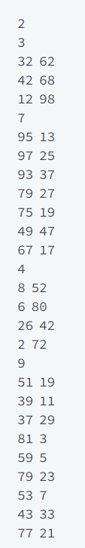
Explanation
For the first test:
The player can roll a 5 and a 6 to land at square 12. There is a ladder to square 98. A roll of 2 ends the traverse in 3 rolls.
For the second test:
The player first rolls 5 and climbs the ladder to square 80. Three rolls of 6 get to square 98. A final roll of 2 lands on the target square in 5 total rolls.

Slide 6
Code
T = int(input().strip())
for t in range(T):
shortcuts = {}
numLadders = int(input().strip())
for l in range(numLadders):
src, dst = [int(item) - 1 for item in input().strip().split()]
shortcuts[src] = dst
numSnakes = int(input().strip())
for s in range(numSnakes):
src, dst = [int(item) - 1 for item in input().strip().split()]
shortcuts[src] = dst
board = [0] + [None] * 99
dst = 0

Slide 7
while dst < 99:
dst += 1
moves = board[dst]
sources = [cell for cell in board[max(dst - 6, 0): dst] if cell is not None]
if not sources:
continue
moves = min(sources) + 1
new_dst = shortcuts.get(dst, dst)
if board[new_dst] is None or moves < board[new_dst]:
board[new_dst] = moves
dst = min(dst, new_dst)
print(board[-1] if board[-1] is not None else '-1')

Slide 8
Input & Output
Test Case 1 Input:
3
2
3 54
37 100
1
56 33
2
3 57
8 100
1
88 44
1
7 98
1
99 1
Test Case 1 Output:
3
2
2

Slide 9
Input & Output
Test Case 2 Input:
1
1
3 90
7
99 10
97 20
98 30
96 40
95 50
94 60
93 70
Test Case 2 Output:
-1

Slide 10
Input & Output
Test Case 3 Input:
2
2
5 66
9 88
1
67 8
1
3 90
7
99 10
97 20
98 30
96 40
95 50
94 60
93 70
Test Case 3 Output:
4
-1

Slide 11
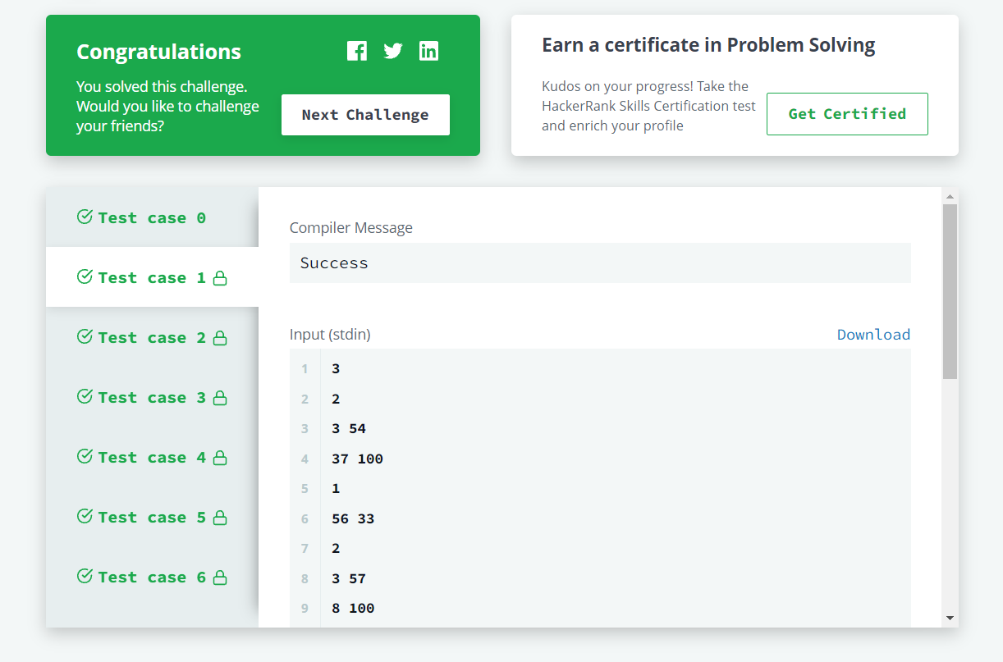
Screenshots
Test Case 1:

Slide 12
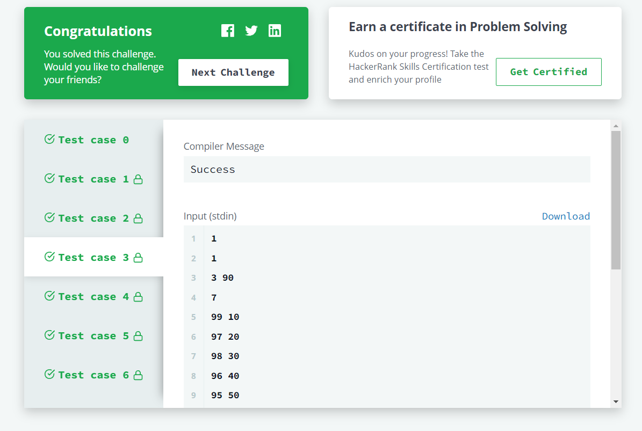
Test Case 2:

Slide 13

Test Case 3:

Slide 14
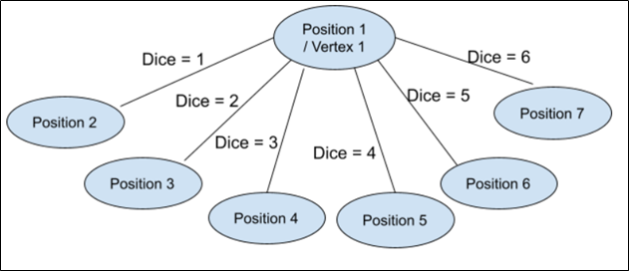
Description of Method Used
The idea is to consider the given snake and ladder board as a directed graph, with the number of vertices equal to the number of cells in the board. The problem reduces to finding the shortest path in a graph. Every vertex of the graph has an edge to the next six vertices, if the next 6 vertices do not have a snake or ladder.
If no snake or ladder:

Slide 15
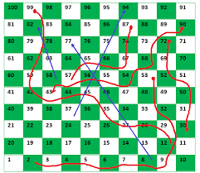
If any of the next six vertices has a snake or ladder, then the edge from the current vertex goes to the top of the ladder or tail of the snake.
Since all edges are of equal weight, we can efficiently find the shortest path using Breadth First Search of the graph.
Complexity of Algorithm used
Time complexity of the above solution is O(N), as every cell is added and removed only once from the queue, and a typical enqueue or dequeue operation takes O(1) time.

Slide 16
Graph Representation
Each block from 1 to 100 is a vertex.
Each possible move from a dice roll is an edge.
Start vertex is 1. End vertex is 100.

Slide 17
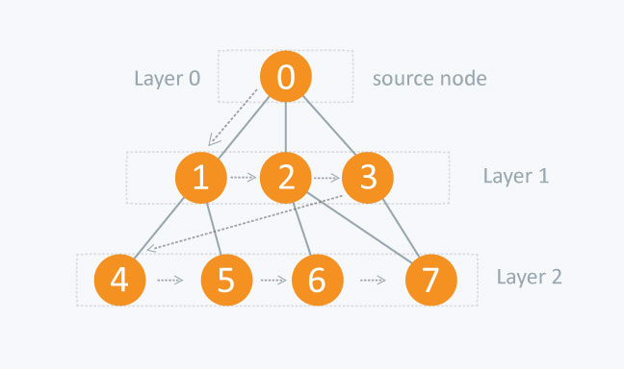
Breadth First Search (BFS) of a Graph:
BFS is a traversing algorithm where you start traversing from a selected node (source or starting node) and traverse the graph layerwise, thus exploring the neighbour nodes (nodes which are directly connected to source node). You then move towards the next-level neighbour nodes.
As the name BFS suggests, you are required to traverse the graph breadthwise as follows:
First move horizontally and visit all the nodes of the current layer
Then move to the next layer
Consider the given diagram. The distance between
the nodes in layer 1 is comparatively lesser than the
distance between the nodes in layer 2. Therefore, in
BFS, you must traverse all the nodes in layer 1 before
you move to the nodes in layer 2.

Slide 18
References
https://www.hackerrank.com/challenges/the-quickest-way-up/problem
https://www.geeksforgeeks.org/snake-ladder-problem-2/
https://www.geeksforgeeks.org/breadth-first-search-or-bfs-for-a-graph/

Slide 19
Conclusion
We solved the Snakes and Ladders Problem by considering the board as a directed graph, and used Breadth First Search. This method efficiently found the shortest path to the top, with minimum number of dice throws.

Slide 20
THANK YOU

